Slide 1



Introducing Node
Lucas Jellema
15th May 2017, Fontys Hogeschool, Eindhoven

Slide 2
Agenda
Introduction of Node (fka Node.JS)
Server side JavaScript – hello world!
The node ecosystem
HTTP Request Handling, Express & outbound HTTP Calls
Handson Workshop
Server push, emailing, promises and interacting with MongoDB & Oracle
More Handson Workshop

Slide 3
Overview
Get used to it: JavaScript on the Server
First steps with Node.js and yes: hello world!
Some language essentials: functions (and closures)
Modules and npm
The Single Thread or: the quest for scalability
Handling HTTP requests
static file serving
serving rich client web applications [such as Oracle JET]
Implementing REST APIs and mBaaS (and iPaaS)
Making HTTP calls to external APIs and Services
Database interaction from Node.js

Slide 4
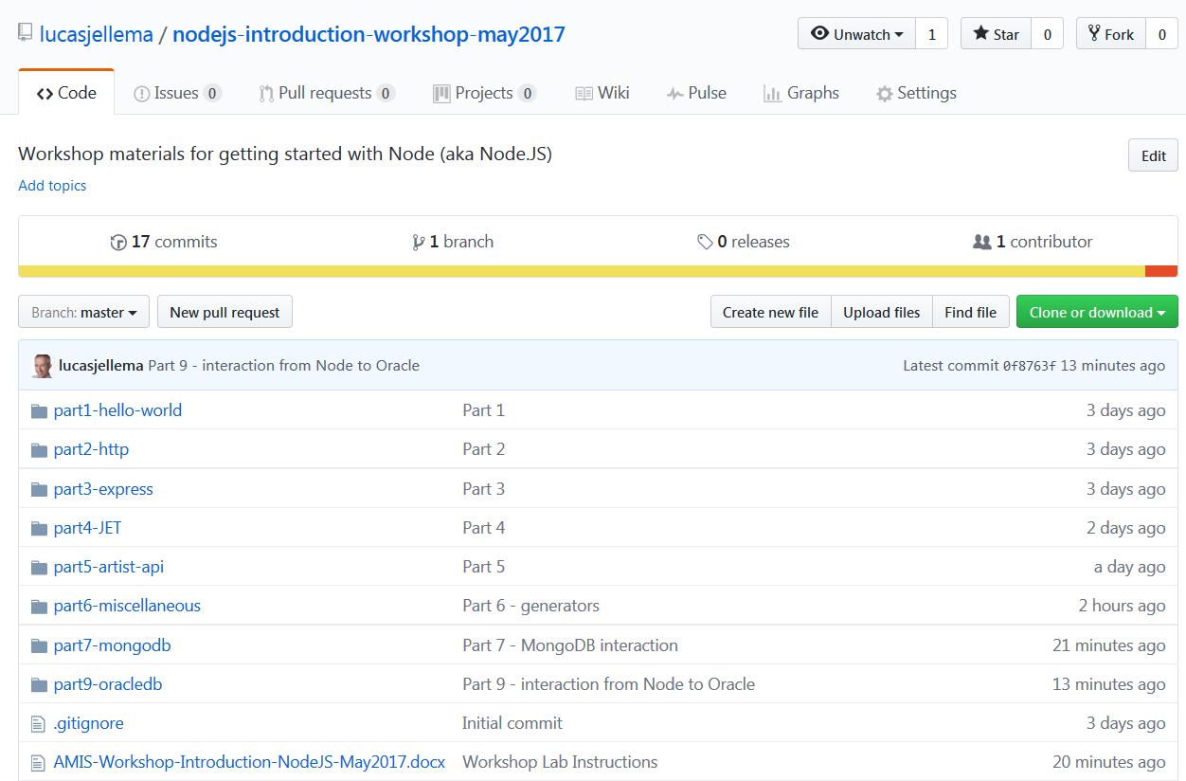
Supporting Resources on GitHub
https://github.com/lucasjellema/nodejs-introduction-workshop-may2017

Slide 5
Are these terms familiar?
REST
DevOps
Apache Kafka
NoSQL [database]
microservices
WebSockets
Angular
git & GitHub
API
Cloud
Docker [containers]
JSON
Server less computing
(AWS Lambda/Azure Functions)
ngrok

Slide 6

JavaScript
Notes:
https://www.w3.org/community/webed/wiki/A_Short_History_of_JavaScript

Slide 7
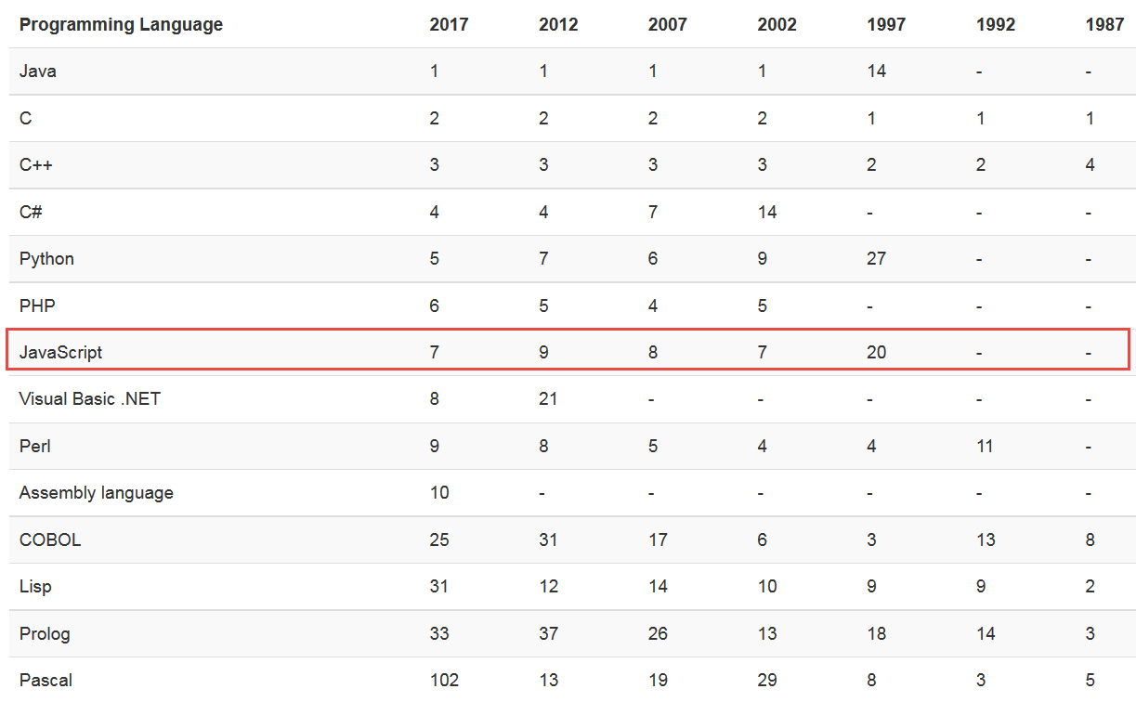
Tiobe – long term history

Slide 8
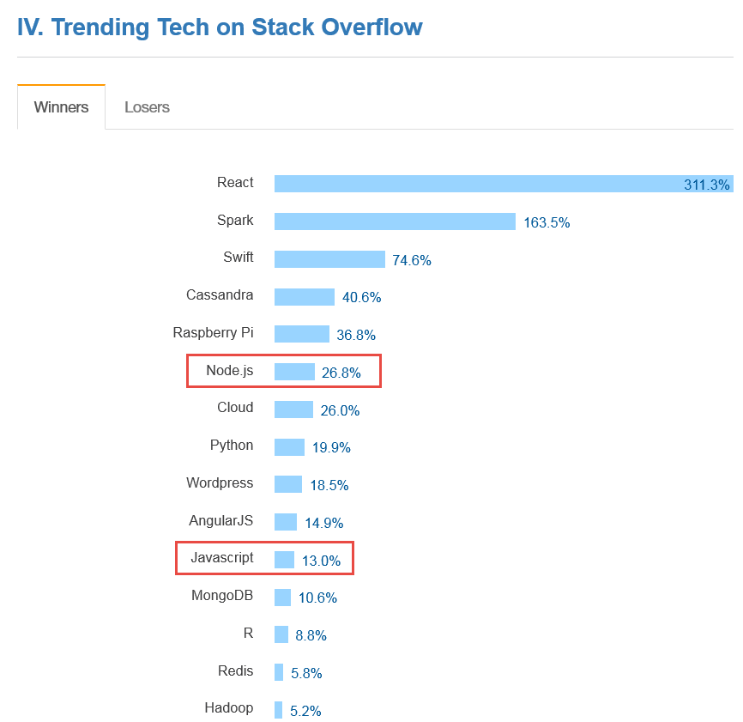
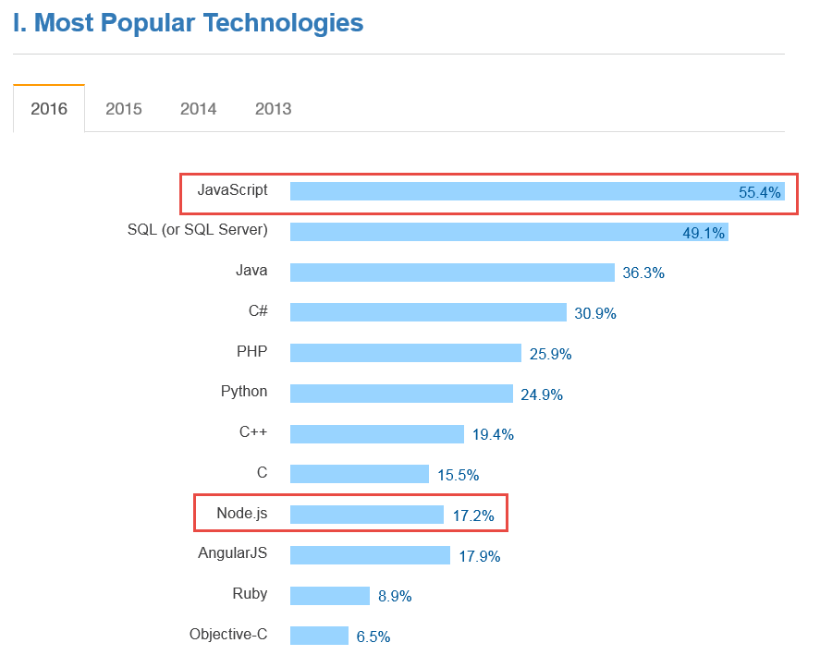
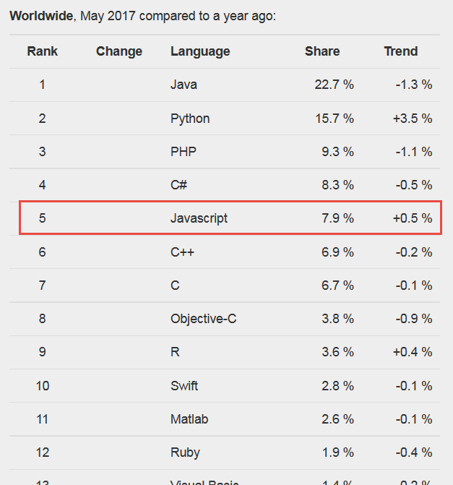
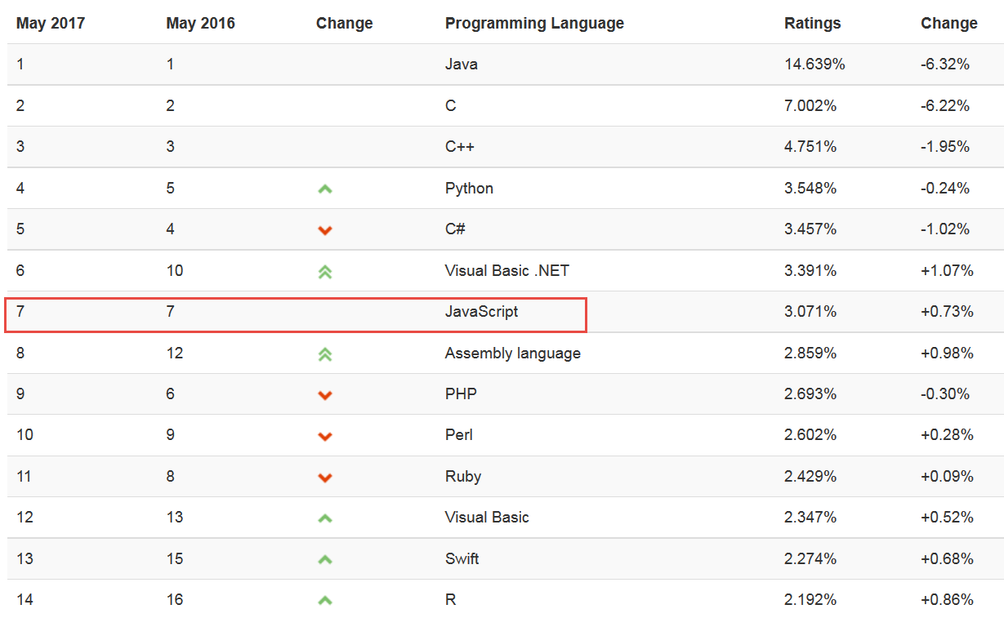
Popularity Ratings…
Notes:
http://stackoverflow.com/research/developer-survey-2015#tech
https://insights.stackoverflow.com/survey/2016#technology
http://pypl.github.io/PYPL.html
https://www.tiobe.com/tiobe-index/

Slide 9
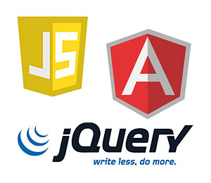

JavaScript in enterprise architecture
DB
Mobile Client
Web Tier
Static file serving
REST APIs
Business Tier
Integration
Orchestration/ BPM
Background Jobs
ERP
Browser
SaaS
External Service
External Service

Slide 10
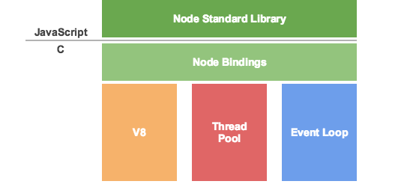

Node.js is like a JS-DK – JavaScript Virtual Machine
Custom Node.js app
Custom Node.js app
Custom Node.js app
machine code
Notes:
See: http://khan.io/2015/02/25/the-event-loop-and-non-blocking-io-in-node-js/

Slide 11
Brief History of Node.js
2009 – unveiled by Ryan Dahl, written on Linux, leveraging Google V8
2010
Initial release of express – the default web application server framework
2011
package manager npm introduced – to publish and share open-source Node.js libraries and simplify installation, updating and uninstallation of libraries
Native Windows implementation of Node.js released
2011-2015 Many Cloud Platforms supporting Node.js
Heroku, Joyent, Cloud Foundry, Nodester, NodeJitsu, Microsoft Azure, IBM BlueMix, Google AppEngine, AWS, …
Notes:
https://github.com/oracle/node-oracledb

Slide 12
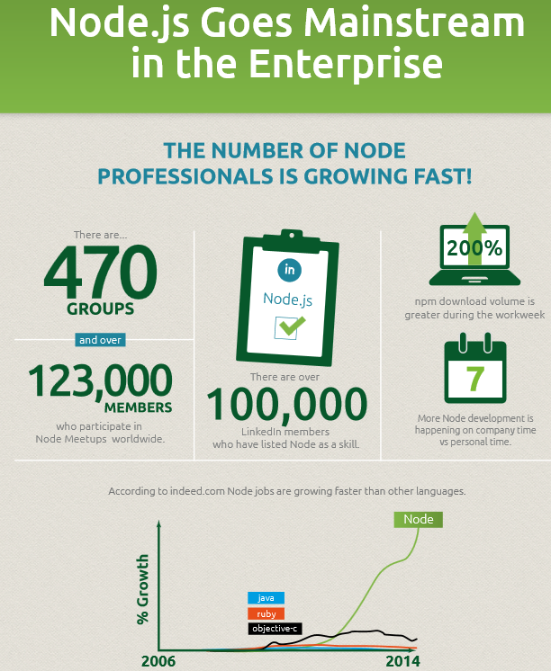
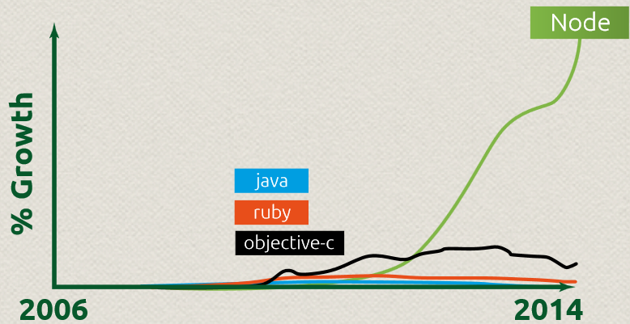
Notes:
https://bsdmag.org/nodejsinbusiness/

Slide 13
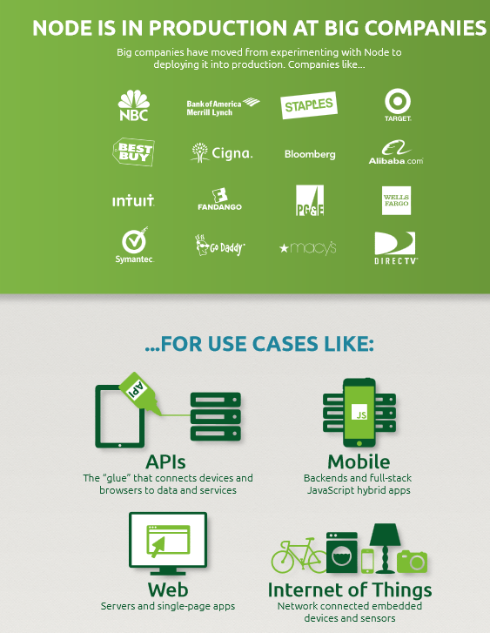
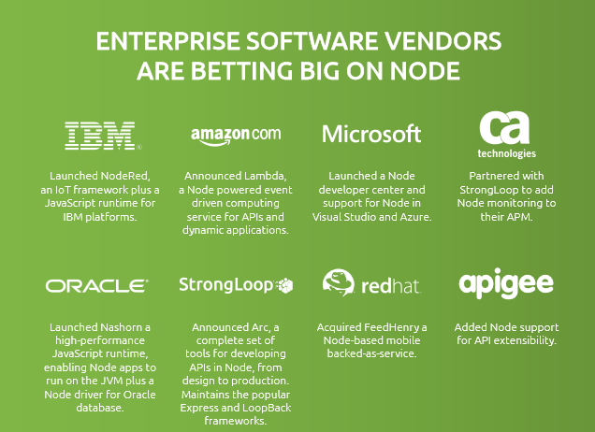

Slide 14
Brief History of Node.js
2015
Various forks brought back together: Node v4.0 including V8 with ES6 features
Open Source under Governance by the Node.js Foundation under Linux Foundation
Support for ARM processors
Oracle releases node-oracledb Database Driver for Node.js
2016/2017
Node is gradually becoming the new denominator (taking over from Node.JS)
Major steps in JavaScript (ES6)
More Tool support for Node
Node one of primary technologies for Serverless Computing (e.g. AWS Lambda) as well as for microservices
Rapid evolution of Node releases
Current release: 6.10.3 (LTS) and 7.4.0 (Current)
Notes:
https://github.com/oracle/node-oracledb

Slide 15
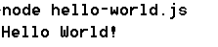
Hello World
// my first Node.js program
console.log("Hello World!");

Slide 16

Hello World – using a function
function greeting() {
console.log("Hello World!");
}
greeting();

Slide 17

Hello World – read commandline arguments
function greeting(greetedPerson) {
console.log("Hello "+ greetedPerson + "!");
}
// assume command line: node hello-world-3.js someName
var greetee = process.argv[2];
greeting(greetee);

Slide 18

Hello World – pass around a function reference
var g = function greeting(greetedPerson) {
console.log("Hello "+ greetedPerson + "!");
}
var greetee = process.argv[2];
g(greetee);

Slide 19

Hello World – have one function execute [a reference to ] another
var g = function greeting(greetedPerson) {
console.log("Hello "+ greetedPerson + "!");
}
var greetee = process.argv[2];
function reception( greetFunction, greetee) {
greetFunction(greetee); // execute the passed in function
}
reception(g, greetee);

Slide 20
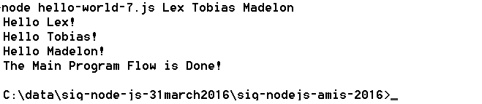
Hello World – callback functions and time outs – no state yet
// callback functions used with timeout
var g = function (greetedPerson) {
console.log("Hello "+ greetedPerson + "!");
}
var r = function ( greetFunction, greetee) {
greetFunction(greetee);
}
for (var i=2;i<process.argv.length;i++) {
setTimeout( r(g, process.argv[i]), i*1500);
}
console.log('The Main Program Flow is Done!');

Slide 21
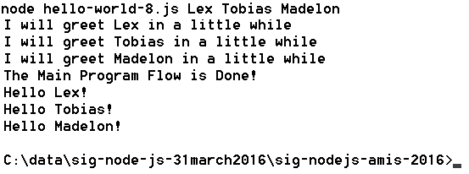
Hello World – closures with state executed on time out
var g = function (greetedPerson) {
console.log("Hello "+ greetedPerson + "!");
}
function getGreeter ( greetee, greetFunction) {
var toGreet = greetee;
console.log('I will greet '+ greetee + ' in a little while');
return function () { greetFunction(toGreet)}; // the closure }
for (var i=2;i<process.argv.length;i++) {
setTimeout( getGreeter( process.argv[i], g), i*1500);
}
console.log('The Main Program Flow is Done!');

Slide 22
Modules
Node programs can be organized in modules
A module is file that exports a scope that may contain (public) functions and shared objects
Modules are ‘imported’ through the require function
Add a line such as var localRef = require(‘moduleName’); in a file to get access at runtime to all the goodies from the module
Node ships with a set of core modules that can be required into any program – without additional installation or configuration; for example:
fs: file system operations
path: string transformations around file system operations
os: access to some operating systems details
util: utility functions, for example util.log to log messages to console with timestamp
http: for HTTP protocol based network operations

Slide 23
File manipulation from Node.js - using core module fs
//write a file with all command line arguments on separate lines
var fs = require('fs')
, util = require('util');
process.argv.slice(2).forEach(function (val) {
fs.appendFileSync("./output.txt", val + "\n");
});
util.log('The Main Program Flow is Done!');

Slide 24
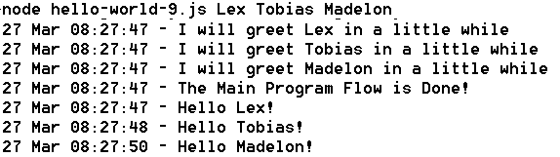
Hello World – using core module util
var util = require('util');
var g = function (greetedPerson) {
util.log(util.format('Hello %s!', greetedPerson));
}
function getGreeter ( greetee, greetFunction) {
var toGreet = greetee;
util.log( util.format('I will greet %s in a little while', toGreet));
return function () { greetFunction(toGreet)};
}
process.argv.slice(2).forEach(function (val, index, array) {
setTimeout( getGreeter(val, g), index*1500);
});
util.log('The Main Program Flow is Done!');

Slide 25
Packages
A package is a bundle of resources that supports development of a node application
Design time (test, code analyze, format, browserify, package, …)
Run time
A package can contain one or more modules that may or may not be intended to be ‘required’ into a node application
Packages are [downloaded and] added to the source folders of a node application
Package management can be tricky
An application can depend on multiple packages
Packages can depend on multiple [versions of] packages themselves
Gathering and keeping up to date all compatible versions of all required packages is potentially complex, time consuming and error prone
Enter: npm
and package.json – the closest thing to a pom-file

Slide 26
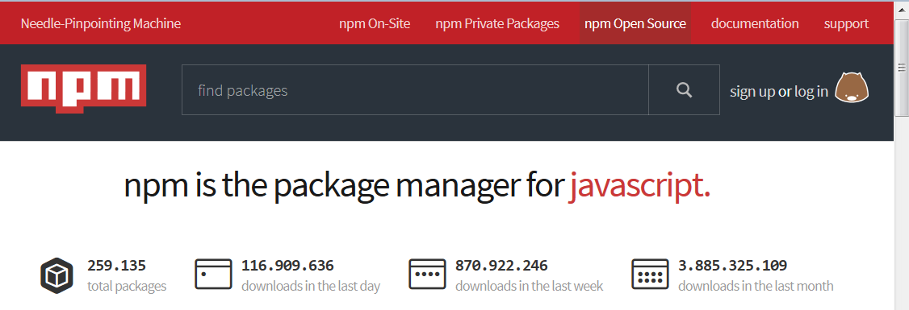
Reusing node modules
“So that's what npm is. It's a way to reuse code from other developers, and also a way to share your code with them, and it makes it easy to manage the different versions of code.”
www.npmjs.org

Slide 27
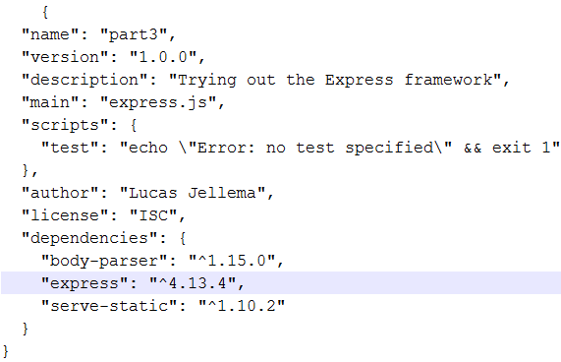
npm
Bring in a package to your current application
npm install <package name> The package is downloaded and installed in folder node_modules
Create a new application with a neat description
npm init This will create a package.json file that describes the [Node.js] application and its dependencies
Use
npm install <package name> --save To have dependencies on the package added to the package,json file
npm install To have all packages listed in package.json installed or updated into the node_modules folder

Slide 28
Node.js can handle incoming HTTP requests
Similar to a Java Servlet or PHP page, a Node.js application can contain logic to interpret and respond to an HTTP request
Web Tier
Static file serving
REST APIs
Browser
http request
Any other HTTP client

Slide 29
Core Modules for (inbound & outbound) networking: http, https, net, dgram
No separate installation required (included with core Node.js)
Handle incoming request and/or make outbound request
Handle URL (path, query parameters, post payload or Form encoding or file upload)
Handle headers, encoding, compression, …
Web Tier
http(s) request
http(s) request

Slide 30
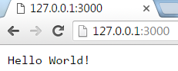
Simplest form of HTTP handling
// invoke from browser or using curl: curl http://127.0.0.1:3000
var http = require('http');
var server = http.createServer(function handleRequest(req, res) {
res.write('Hello World!');
res.end();
}).listen(3000);
console.log('server running on port 3000');
Web Tier
http(s) request

Slide 31
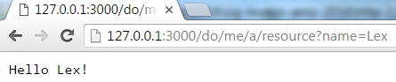
Interpret request and respond appropriately
// invoke: curl http://127.0.0.1:3000/do/me/a/resource?name=Lex
var http = require('http')
, url = require('url') ;
var server = http.createServer(function handleRequest(req, res) {
console.log('URL '+ req.url);
var queryObject = url.parse(req.url,true).query;
var name = queryObject.name;
console.log('path: '+url.parse(req.url).pathname);
console.log('queryObject: '+JSON.stringify(queryObject));
res.write('Hello '+ name + '!');
res.end();
}).listen(3000);
Web Tier
http(s) request

Slide 32
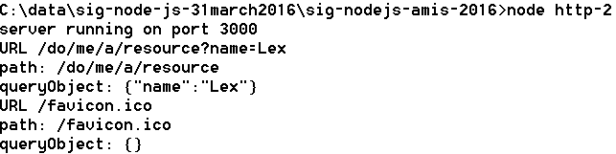
Interpret request and respond appropriately
// invoke: curl http://127.0.0.1:3000/do/me/a/resource?name=Lex
var http = require('http')
, url = require('url') ;
var server = http.createServer(function handleRequest(req, res) {
console.log('URL '+ req.url);
var queryObject = url.parse(req.url,true).query;
var name = queryObject.name;
console.log('path: '+url.parse(req.url).pathname);
console.log('queryObject: '+JSON.stringify(queryObject));
res.write('Hello '+ name + '!');
res.end();
}).listen(3000);
Web Tier
http(s) request

Slide 33
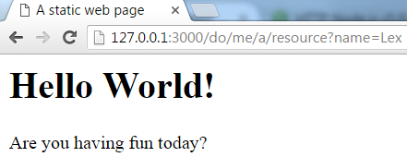
Static File Serving
// serve static file: /public/index.html
var http = require('http')
, fs= require('fs');
var server = http.createServer(function handleRequest(req, res) {
res.writeHead(200, { 'content-type': 'text/html' });
fs.createReadStream('./public/index.html').pipe(res);
}).listen(3000);
console.log('server running on port 3000');
Web Tier
http(s) request
Local file system
index.html

Slide 34
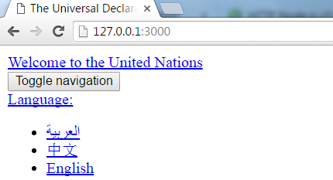

Remote Resource Serving – http in and http out
var http = require('http');
var options = {
host: 'www.un.org', path: '/en/universal-declaration-human-rights/' };
var server = http.createServer(function handleRequest(req, res) {
res.writeHead(200, { 'content-type': 'text/html' });
http.get(options, function handleRemoteResponse(resp) {
var body="";
resp.on("data", function(chunk) { //response returned in chunks
body = body+chunk;
});
resp.on("end", function() { //when response is complete, pass it on
res.end(body);
});
}).on('error', function(e) {
console.log("Got error: "+ e.message);
});
}).listen(3000);
Remote Website
http
request

Slide 35
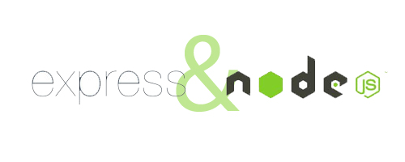
Express web application framework
Fast, unopinionated, minimalist web framework for Node.js
Framework on top of core Node.js top facilitate incoming HTTP requests
“Express provides a thin layer of fundamental web application features, without obscuring Node.js features that you know and love.”
Convenient for
Web Server for static files
API implementation (REST)
Any incoming HTTP request handling
Express is distributed as npm package
npm install express

Slide 36

Express - Simplest form of HTTP handling
// invoke from browser or using curl: curl http://127.0.0.1:3000
var express = require('express')
, http = require('http');
var app = express()
.use(function (req, res, next) {
res.end('Hello World!');
});
// Create HTTP server with Express app as the request listener
http.createServer(app)
.listen(3000);
Web Tier
http(s) request

Slide 37
Express – Even simpler form of HTTP handling (or at least simpler code)
// invoke from browser or using curl: curl http://127.0.0.1:3000
var express = require('express');
express().use(function (req, res, next) {
res.end('Hello World!');
}).listen(3000);
console.log('server running on port 3000');
Web Tier
http(s) request

Slide 38
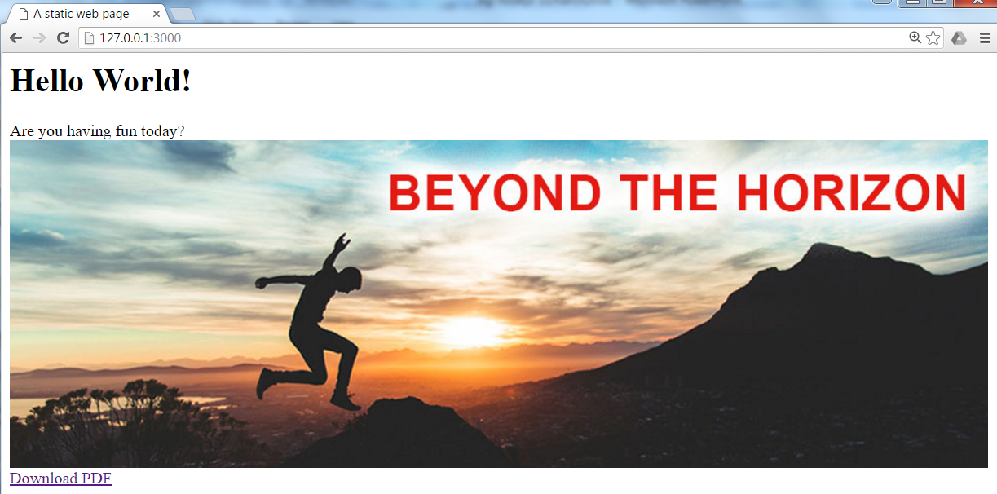
Static File Serving
// static file server for all resources in public and below
// will server public/index.html when invoked at http://127.0.0.1:3000
var express = require('express'); //npm install express
express().use(express.static(__dirname + '/public'))
.listen(3000);
console.log('server running on port 3000');
Integration Tier
Local file system
http(s) request
index.html
image.jpg
some-pdf.pdf

Slide 39

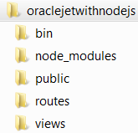
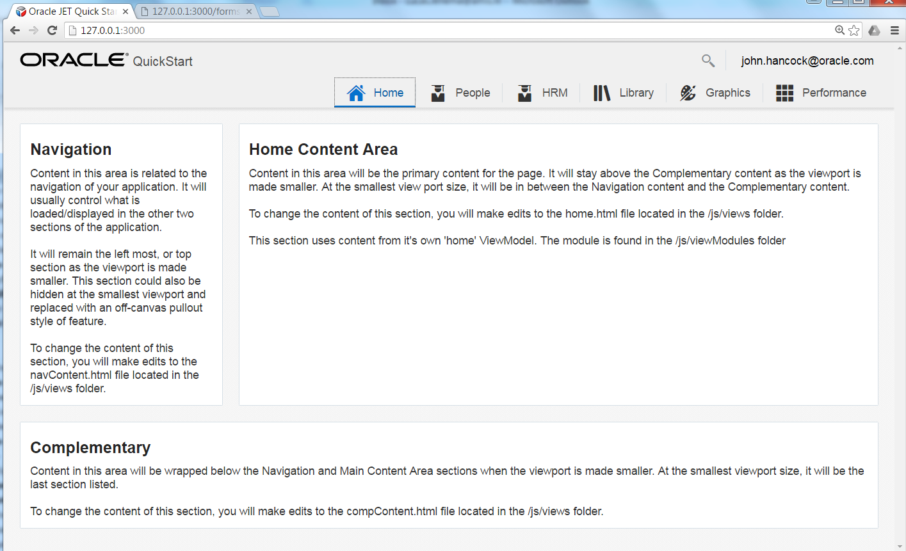
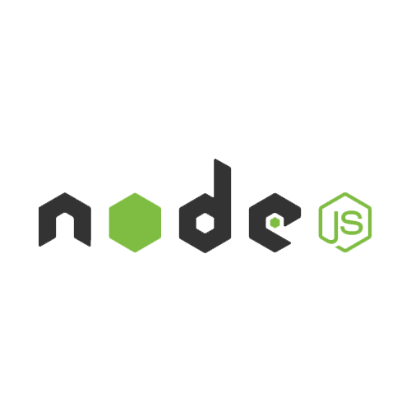
Oracle JET on Node.js
Oracle JET is a rich client web application
All the action is on the client
Role of Node.js: serve the JET application with all its required resources
All static HTML, CSS and JS files
app.js
Notes:
https://technology.amis.nl/2016/02/07/deploying-an-oracle-jet-application-to-application-container-cloud-and-running-on-node-js/

Slide 40
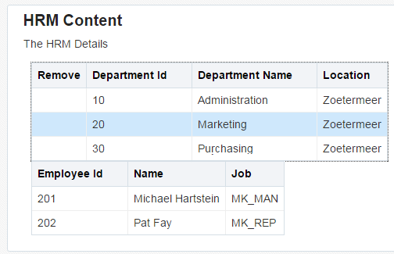
Oracle JET on Node.js
Oracle JET is a rich client web application
All the action is on the client
Role of Node.js: serve the JET application with all its required resources
All static HTML, CSS and JS files
Additionally: Node.js can provide back end APIs and proxy that JET application leverages
app.js
REST API
Notes:
https://technology.amis.nl/2016/02/07/deploying-an-oracle-jet-application-to-application-container-cloud-and-running-on-node-js/

Slide 41

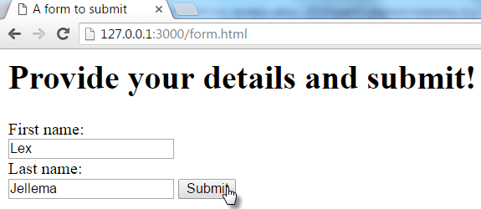
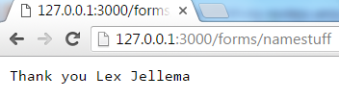
Handling Form Submit and other HTTP POST requests
// static file server for all resources in public and below
// AND handle forms submission to path /forms/...
var express = require('express'); //npm install express
var bodyParser = require('body-parser'); // npm install body-parser
var app = express()
.use(bodyParser.urlencoded({ extended: true}))
.post('/forms/*', function (req, res) { //process
console.log(JSON.stringify(req.body));
res.end('Thank you '+ req.body.firstname +' '+req.body.lastname);
})
.use(express.static(__dirname + '/public'))
.listen(3000);
Integration Tier
Local file system
POST request

Slide 42
Handling REST GET requests
var express = require('express'), fs = require('fs');
var departments= JSON.parse(fs.readFileSync('departments.json', 'utf8'));
var app = express()
.get('/departments/:departmentId', function (req, res) {
var department = getDepartment(req.params['departmentId']);
console.log(JSON.stringify(department));
res.send( department);
})
.get('/departments', function (req, res) {
res.send( departments);
})
.use(express.static(__dirname + '/public'))
.listen(3000);
function getDepartment(depIdentifier) {
for (var i=0; i< departments.length; i++) {
if (departments[i].DEPARTMENT_ID == deptIdentifier) {
return departments[i];
}//if
}//for
}// getDepartment
Integration Tier
Local file system
GET request
departments .json

Slide 43
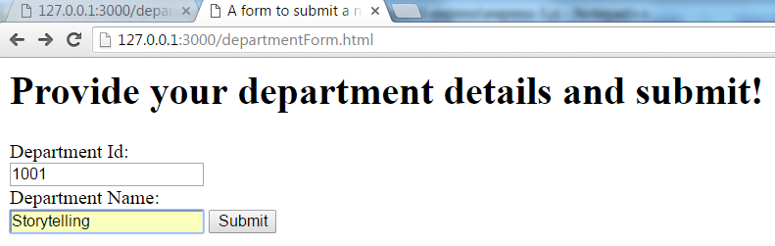
Handling REST GET & Form POST requests
var express = require('express'),bodyParser = require('body-parser') , fs = require('fs');
var app = express()
.use(bodyParser.urlencoded({ extended: true}))
.post('/forms/department', function (req, res) { //process
console.log(JSON.stringify(req.body));
departments.push( {"DEPARTMENT_ID":req.body.departmentId ,"DEPARTMENT_NAME":req.body.departmentName}); res.end('Thank you for the new department '+ req.body.departmentId+" "+req.body.departmentName);
}) .get('/departments/:departmentId', function (req, res) {
…
.listen(3000);
Integration Tier
Local file system
GET request
Form Submit
departments .json

Slide 44
Serve Department details – retrieved from external REST API
var express = require('express'),bodyParser = require('body-parser') , fs = require('fs'), https = require('https');
var app = express()
.get('/departmentdetails/:departmentId', function (req, res) { var departmentId = req.params['departmentId'];
var department = getDepartment(departmentId);
// get employee details for department from remote API
https.get({ host: 'data-api-oraclecloud.com', port: 443,
path: '/departments/'+departmentId, method: 'GET'
}, function handleRemoteResponse(resp) {
var body="";
resp.on("data", function(chunk) {body += chunk; });
resp.on("end", function() {
department.employees = JSON.parse(body);
res.send(department); });
});
})
.listen(3000);
REST API
Integration Tier
Local file system
GET request
departments .json

Slide 45

And now for a real USP

Slide 46
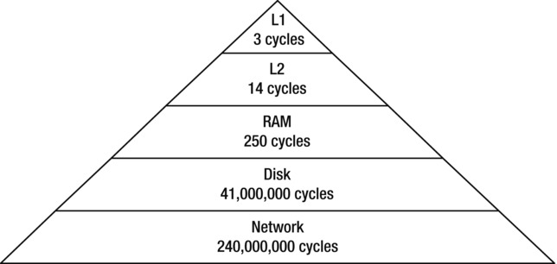
Access speed for data retrieved from various sources
Source: Beginning Node.js - by Basarat Ali Syed Apress, released: December 2014

Slide 47
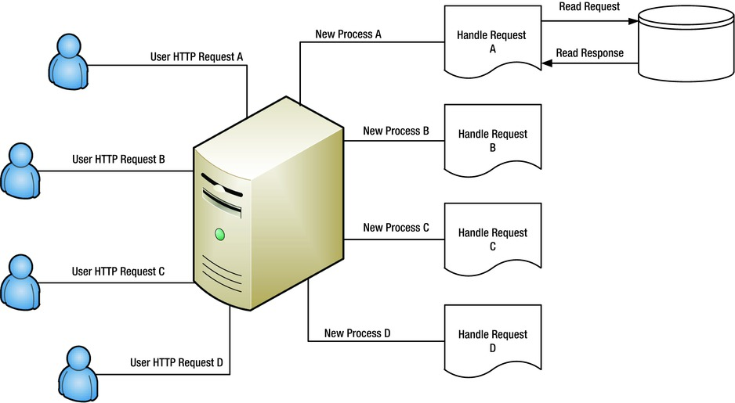
Threads in web application handling HTTP-requests
Source: Beginning Node.js - by Basarat Ali Syed Apress, released: December 2014

Slide 48
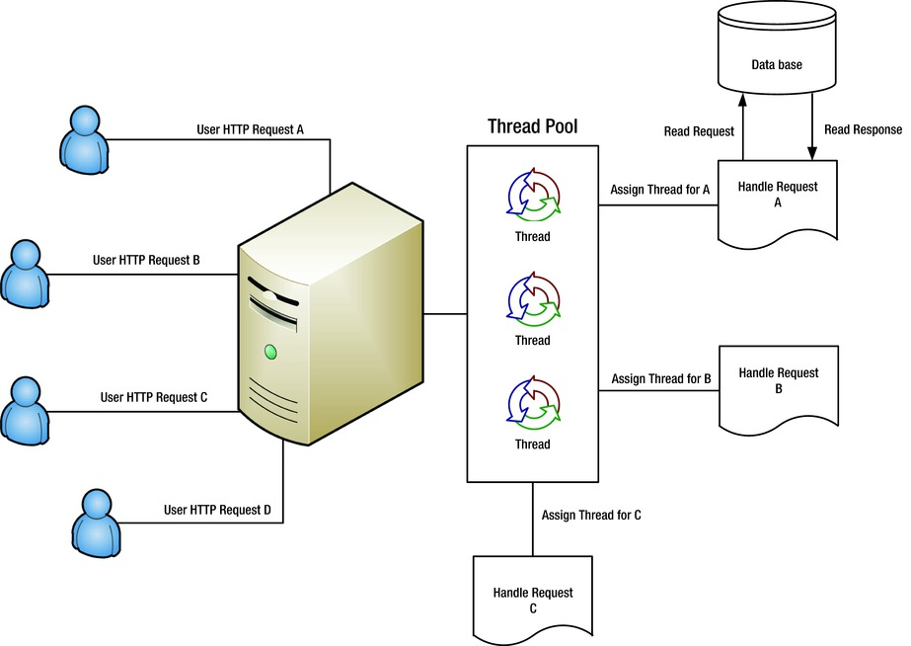
Ready-to-run Threads in web application handling HTTP-requests
Source: Beginning Node.js - by Basarat Ali Syed Apress, released: December 2014

Slide 49

Warehouse
shopping area
cash registers
waiting area
desk to collect
large pieces
Only a single desk to handle all customers who want to have stuff from the warehouse brought to them – compare with over a dozen cash registers
Exit

Slide 50
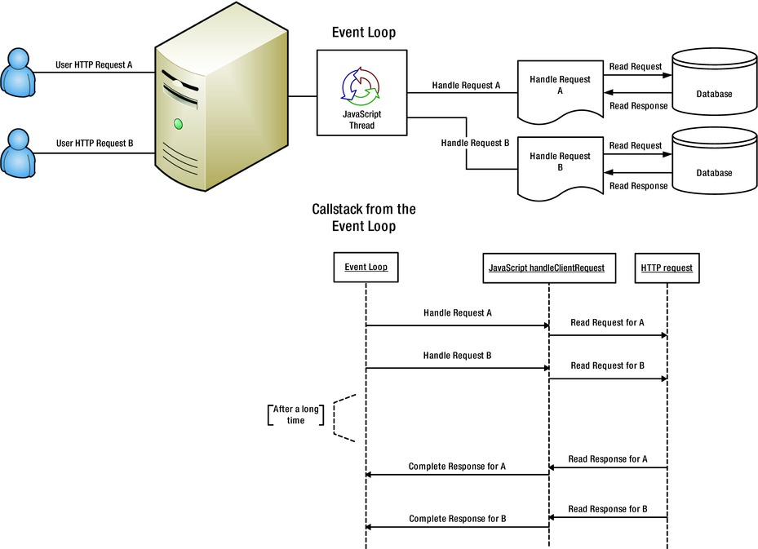
Single Thread model in Node.js

Slide 51
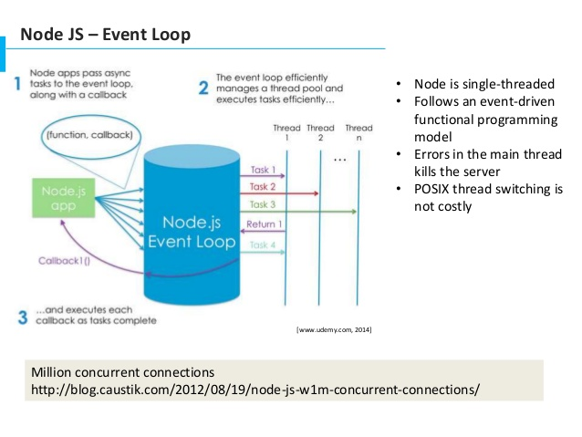
Single Thread
No synchronous calls or blocking waits are done on the thread
intensive work too is pushed to another process
After the question is asked, the thread moves
When a response arrives – as an asynchronous event – the callback function is given the opportuniy to act on it
Again, as quickly as possible, not tying up shared resources!

Slide 52
Single Thread
No synchronous calls or blocking waits are done on the thread
intensive work too is pushed to another process
After the question is asked, the thread moves
When a response arrives – as an asynchronous event – the callback function is given the opportuniy to act on it
Again, as quickly as possible, not tying up shared resources!

Slide 53
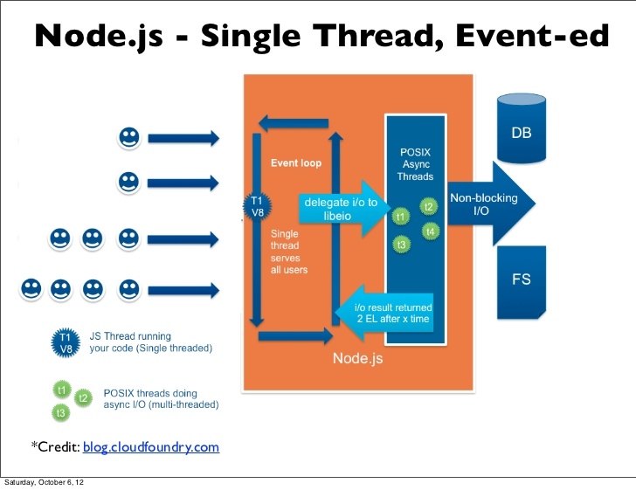

Slide 54
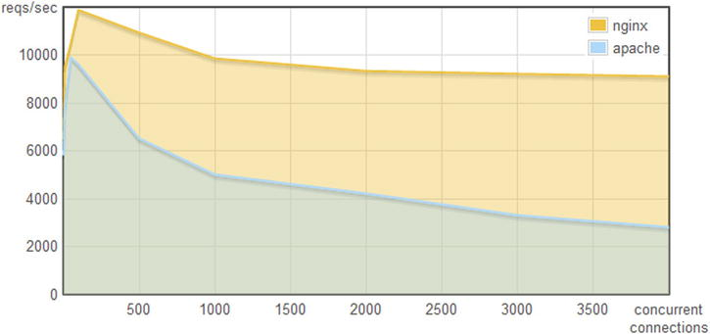

The single thread way: Nginx

Slide 55
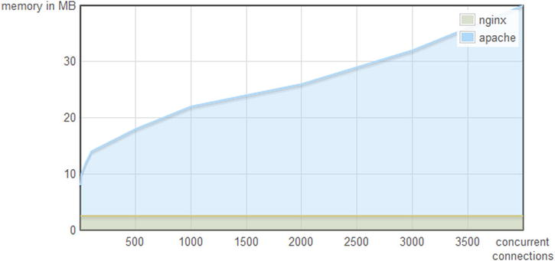
The single thread way: Nginx

Slide 56
Asynchronously assembling the HTTP response
Receive HTTP request
Possibly leverage cookie to re-establish state/context
Set work in motion to collect data (remote API call, DB call) and register callback – with original request scope
Stop processing, vanish, release resources
When callback is invoked, use response to construct the response
Complete and send the response
Callback == Closure
(function to execute with context to execute in)

Slide 57
Handson – Part 1
Fetch Sources and Labs from GitHub
Install Node v6 or v7 locally (or in VM or in Docker Container)
Go through:
Part 1 – Hello World
Part 2 – Core HTTP
Part 3 – Express
Part 4 – Rich Client Web Application

Slide 58
Agenda
Introduction of Node (fka Node.JS)
Server side JavaScript – hello world!
The node ecosystem
HTTP Request Handling, Express & outbound HTTP Calls
Handson Workshop
Server push, emailing, promises and interacting with MongoDB & Oracle
More Handson Workshop

Slide 59
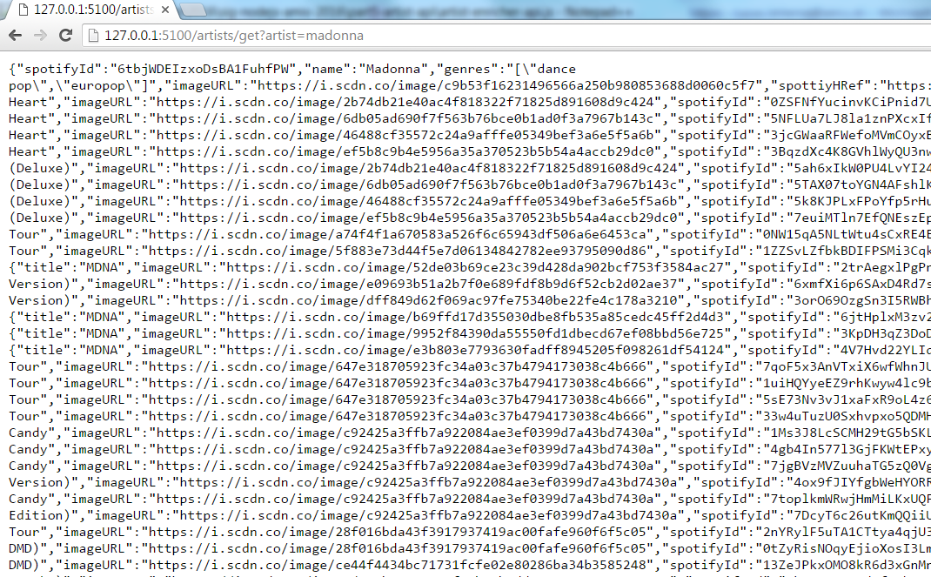
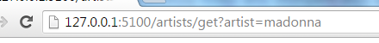


Artist API
Provide rich JSON message for an artist
External APIs invoked at Spotify
External calls are made in parallel
Waiting is done in parallel
Constructing the response is done when all responses are in
GET request
for some artist
Integration Tier

Slide 60
async
The node module async is a utility module which provides straight-forward, powerful functions for working with asynchronous JavaScript.
Available for server side Node.js and for use in the browser client
Program easily with asynchronous interactions
Coordinate parallel or sequential calls and deal with errors
Example operations:
Map
Reduce
Filter
Waterfall
Parallel
ForEachOf
Series
Notes:
https://github.com/caolan/async

Slide 61
async – execute in parallel
var async = require(‘async')
, fs = require(‘fs'); var obj = {dev: "/dev.json", test: "/test.json", prod: "/prod.json"};
var configs = {};
async.forEachOf(obj, function (value, key, callback) {
… // work on populating configs
}, function (err) { // when all parallel actions are done – do something
if (err) { console.error(err.message); return;}
// configs is now a map of JSON data
doSomethingWith(configs);
})
For each property in the object…
… execute this function
When all parallel branches under forEachOf are done, do this function

Slide 62
async – execute in parallel
var async = require(‘async')
, fs = require(‘fs'); var obj = {dev: "/dev.json", test: "/test.json", prod: "/prod.json"};
var configs = {};
async.forEachOf(obj, function (value, key, callback) {
fs.readFile(__dirname + value, "utf8", function (err, data) {
if (err) return callback(err);
try {
configs[key] = JSON.parse(data);
} catch (e) {
return callback(e);
}
callback();
});
}, function (err) { // when all parallel actions are done – do something
if (err) { console.error(err.message); return;}
// configs is now a map of JSON data
doSomethingWith(configs);
})
For each property in the object…
… execute this function
Asynchronously read the file
.. and when done, call this function
Notify forEachOf of the completion of this branch
When all parallel branches under forEachOf are done, do this function

Slide 63
async – execute in waterfall
var async = require('async')
async.waterfall
( [ … // one or more functions that are executed in a chained fashion: // - fixed order
// - passing output from one function as input into the next
], function (err, result) { // when all chained functions are done – do something
if (err) { console.error(err.message); return;}
// do something with result
})// end of waterfall
When all steps in the waterfall are complete, do this function

Slide 64
async – execute in waterfall
var async = require('async')
async.waterfall
( [ function (callback) {
… // do something that is potentially asynchronous callback( errorIfAny, result);
},
function (value, callback) {
…
callback(errorIfAny, result); },
function (value, callback) {
…
callback(errorIfAny, result);
}
], function (err, result) { // when all chained functions are done – do something
if (err) { console.error(err.message); return;}
// do something with result
})// end of waterfall
Start with first asynchronous function in in array
When done executing, then invoke callback to give async.waterfall control
When no error was reported, the next function in the waterfall is called
When all steps in the waterfall are complete, do this function

Slide 65
Structure of Artist API
waterfall
request
request
forEachOf
artist details
album list
main
parallel
request
request
request
artist details
album details
…
request
biography
request

Slide 66
Chain of subsequent asynchronous calls
{
"nextfile": "step2.json"
}
{
"nextfile": "nextStep.json"
}
{
"nextfile": “followUp.json"
}
{
"nextfile": “finalStep.json"
}
{
“actualValue": 42
}
step1.json
step2.json
nextStep.json
followUp.json
finalStep.json
//asynchronous
function readElementFromJsonFile
(fileName, elementToRead, cb)
"step1.json"
"actualValue"
request
request
request
request
request

Slide 67
Chain of subsequent asynchronous calls
readElementFromJsonFile(step1, null, function (err, data) {
if (err) return err;
readElementFromJsonFile(data, null, function (err, data) {
if (err) return err;
readElementFromJsonFile(data, null, function (err, data) {
if (err) return err;
readElementFromJsonFile(data, null, function (err, data) {
if (err) return err;
readElementFromJsonFile(data, 'actualValue', function (err, data) {
if (err) return err;
console.log("Final value = " + data);
});
});
});
});
});

Slide 68
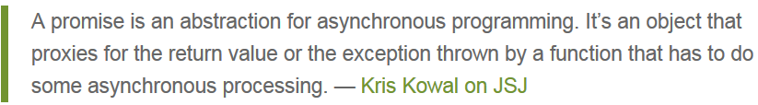
Promises in Javascript
Promises in JavaScript are an alternative for explicit callbacks
A promise represents the later-to-be-provided-result of a call that will asynchronously be handled
function asynchronousAction(param) {
return new Promise((resolve, reject) => { .. the real work … more work
resolve( resultFromHardWork); });
}
asynchronousAction(paramValue) .then( someOtherAsynchronousAction) .then( function (result) { … do something with result })

Slide 69
Promises can be evaluated in parallel and in a chain
Use Promise.all to wait for the resolution of a collection of promises
Use a promise chain to handle a subsequent series of asynchronous actions that depend on each other
Promise Chains can be included in Promise.all
Promise.all( array of promises).then(function (array of results) {})
firstAction(paramValue) .then( secondAction) .then( nextAction) .then( function (result) { … do something with result })

Slide 70
Chain of subsequent asynchronous calls
function readElementFromJsonFile(fileName, elementToRead) {
return new Promise((resolve, reject) => {
fs.readFile(__dirname + '/' + fileName, "utf8", function (err, data) {
...
resolve(element);
});
})// promise
}//readElementFromJsonFile
readElementFromJsonFile(step1)
.then(readElementFromJsonFile)
.then(readElementFromJsonFile)
.then(readElementFromJsonFile)
.then(function (filename) { return readElementFromJsonFile(filename, 'actualValue') })
.then(function (value) { console.log(‘Final value = ' + value); })

Slide 71


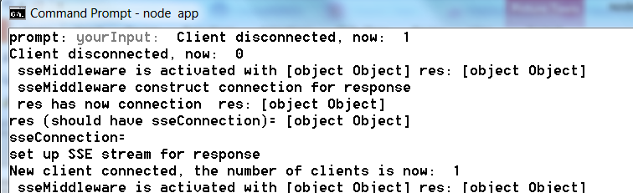

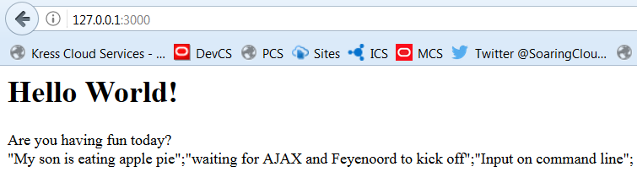

Server sent events
js
onMessage
Gather User Input
Push
app.js
Register SSE client
/updates
sse.js
js
index.html

Slide 72

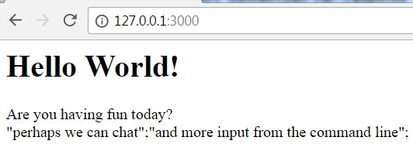
Server sent events
js
onMessage
js
onMessage
Gather User Input
Push
app.js
js
Register SSE client
/updates
sse.js
onMessage
js
index.html

Slide 73
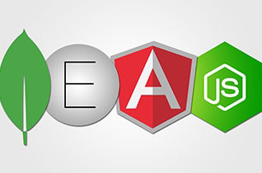
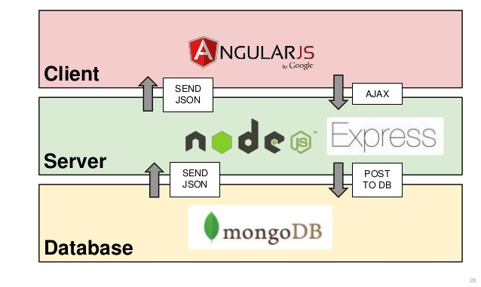
MEAN stack
Modelled after LAMP
End-to-End JavaScript/JSON
Term coined in 2013 (by MongoDB)

Slide 74
NoSQL – relational Databases re-evaluated
Not all use cases require ACID (or can afford it)
Read only (product catalog for web shops)
Inserts only and no (inter-record) constraints
Big Data collected and “dumped” in Data Lake (Hadoop) for subsequent processing
High performance demands
Not all data needs structured formats or structured querying and JOINs
Entire documents are stored and retrieved based on a single key
Sometimes – scalable availability is more important than Consistency – and ACID is sacrificed
CAP-theorem states: Consistency [across nodes], Availability and Partition tolerance can not all three be satisfied

Slide 75
Use Case: Webshop
Webshop – 1M visitors per day
Product catalog consists of millions of records
The web shop presents: product description, images, reviews, pricing details, related offerings, stock status
Products are added and updated and removed every day
Although most products do not change very frequently
Some vendors do bulk manipulation of product details
Webshop visits
searches
product details
orders
Products
Product updates

Slide 76
Use Case: Webshop Technology and architecture considerations
Webshop visits
searches
product details
orders
Products
Product updates
Read only
On line
Speed is crucial
XHTML & JSON
> 1M visits
Data manipulation
Data Quality (enforcement)
<10K transactions
Batch jobs next to online
Speed is nice
firewall

Slide 77


Use Case: Webshop Technology and architecture considerations
DMZ
Nightly generation
Webshop visits
searches
product details
orders
Products
Products
Products
Products
Product updates
Read only
On line
Speed is crucial
XHTML & JSON
> 1M visits
Data manipulation
Data Quality (enforcement)
<10K transactions
Batch jobs next to online
Speed is nice
Read only
JSON documents
Images
Text Search
Scale Horizontally
firewall

Slide 78
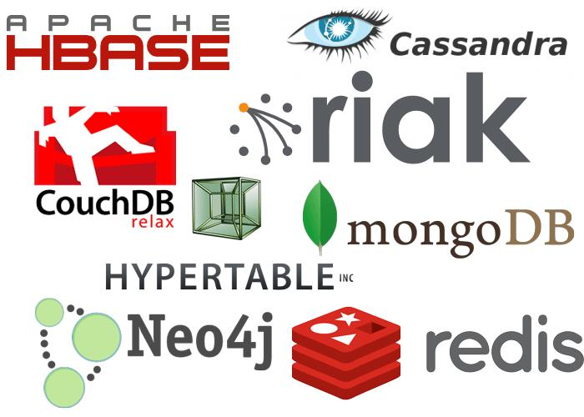

NoSQL and BASE
NoSQL arose because of performance and scalability challenges with Web Scale operations
NoSQL is a label for a wide variety of databases that lack some aspect of a true relational database
ACID-ness, SQL, relational model, constraints
The label has been used since 2009
Perhaps NoREL would be more appropriate
Some well known NoSQL products are
Cassandra, MongoDB, Redis, CouchDB, …
BASE as alternative to ACID:
basically available, soft state, eventually consistent (after a short duration)

Slide 79
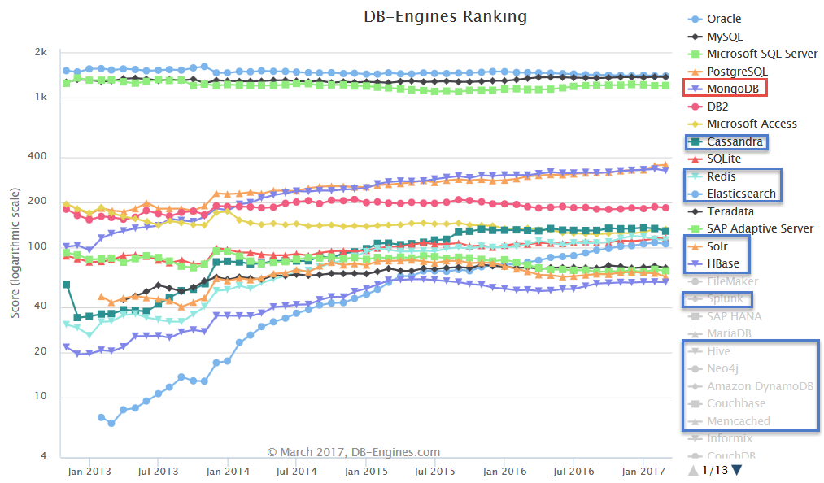
(leading) NoSQL Database products
MongoDB is (one of) the most popular (by any measure)
Cloud (only):
Google BigTable,
AWS Dynamo
Cache (in memory)
ZooKeeper, Redis, Memcached, …
Hadoop/HDFS
Oracle NoSQL (fka Berkeley DB)

Slide 80


Slide 81
History of MongoDB
10gen – startup from 2007 in New York City
Developed database as component in Platform as a Service product
Initial release of MongoDB: 2009
10gen changed its name to MongoDB Inc. in 2013
Offers enterprise support, MongoDB Atlas cloud service, MongoDB Compass, Connectors
Current stable release: 3.4.2 (3.5.2 is in preview)
Open Source - GNU Affero General Public License and the Apache License.
MongoDB == Humongous Database
Evolution of MongoDB is still pretty fast
Some crucial enterprise database capabilities were added fairly recently or are still lacking
MongoDB is number one NoSQL database in terms of popularity

Slide 82
Core Architecture
MongoDB stores JSON documents in a binary format (BSON)
Documents are stored in collections (similar to row or records in tables)
Interaction is through JavaScript
taking the place of SQL for DML and query
Written in C++
Has the V8 JavaScript engine included
Runs on Mac OS X, Windows, Solaris, and most flavors of Linux
Source code is on GitHub
Has GeoSpatial and Tekst indexes and search capabilities
MongoDB, Inc. officially supports drivers for C, C++, C#, Erlang, Java, Node.js, JavaScript, Perl, PHP, Python, Scala, and Ruby

Slide 83

Interacting with Mongodb from Node.js
Connect, create, update
MongoDB Node.js Driver 2.0
Support for ECMAScript 6.0 – Promises for asynch
http://mongodb.github.io/node-mongodb-native/2.0/
Using mongodb in a NodeJS application
npm install mongodb –save
var MongoClient = require('mongodb').MongoClient;

Slide 84

Connecting to server
Connect, create, update
var MongoClient = require('mongodb').MongoClient;
var mongodbHost = '127.0.0.1';
var mongodbPort = '27017';
var mongodbDatabase = 'world';
var url = 'mongodb://'+mongodbHost+':'+mongodbPort + '/' + mongodbDatabase;
MongoClient.connect(url, function(err, db) {
console.log("Connected correctly to server.");
// DO YOUR THING WITH MONGODB
db.close();
console.log("Connection to database is closed.");
}) //connect()

Slide 85
Retrieve data (1a)
Connect, create, update
var MongoClient = require('mongodb').MongoClient;
var mongodbHost = '127.0.0.1';
var mongodbPort = '27017';
var mongodbDatabase = 'world';
var url = 'mongodb://'+mongodbHost+':'+mongodbPort + '/' + mongodbDatabase;
MongoClient.connect(url, function(err, db) {
console.log("Connected correctly to server.");
db.collection('countries').find({},{"sort": [["area",-1]]}) .limit(20).toArray(function(err, results){
console.log("Name of Country Four " +results[3].name + " and size: " +results[3].area); … }

Slide 86
Retrieve data (1B)
Connect, create, update
var MongoClient = require('mongodb').MongoClient;
var mongodbHost = '127.0.0.1';
var mongodbPort = '27017';
var mongodbDatabase = 'world';
var url = 'mongodb://'+mongodbHost+':'+mongodbPort + '/' + mongodbDatabase;
MongoClient.connect(url, function(err, db) {
console.log("Connected correctly to server.");
// using cursors to retrieve data sets in a controlled fashion // note: cursor implements NodeJS Stream - results can be piped
var cursor = db.collection('countries').find({"continent":"Asia"}, {"sort": "name"});
cursor.count(function(err, count){
console.log("Country count in Asia: "+count);
});
cursor.each(function(err, country){
console.log(country.name);
})//each cursor

Slide 87
Retrieve data (2)
Connect, create, update
var aggquery = [ {$sort: {area : -1}}
, {$group:{ _id: '$continent'
, largestCountry : {$first: "$name"}
}
}
];
var aggcursor = db.collection('countries').aggregate(aggquery);
aggcursor.each(function(err, result){
if (err) {
console.log(err);
} else if (result)
console.log(JSON.stringify(result));
}) //each aggcursor
var ccursor = db.collection('countries').find({});
// the cursor returned from find and aggregate implements a NodeJS (readable) Stream
ccursor.on('data', function(doc) {
console.log(doc);
});
ccursor.once('end', function() {
console.log(“Out of countries. Time to move on");
});

Slide 88
Connecting to server – ECMA 6
Connect, create, update
var MongoClient = require('mongodb').MongoClient;
var assert = require('assert'), co = require('co');
var mongodbHost = '127.0.0.1';
var mongodbPort = '27017';
var mongodbDatabase = 'world';
var url = 'mongodb://'+mongodbHost+':'+mongodbPort + '/' + mongodbDatabase;
co(function*() {
// Use connect method to connect to the Server
var db = yield MongoClient.connect(url);
console.log("Connected correctly to server");
// DO YOUR THING WITH MONGODB
// Close the connection
db.close();
}).catch(function(err) {
console.log(err.stack);
});

Slide 89
Retrieve documents – ECMA 6
Connect, create, update
co(function*() {
// Use connect method to connect to the Server
var db = yield MongoClient.connect(url);
console.log("Connected correctly to server");
// find top 20 countries by size
var results = yield db.collection('countries').find({} ,{"sort": [["area",-1]]}).limit(20).toArray();
console.log("Country One " +JSON.stringify(results[0]));
console.log("Name of Country Four " +results[3].name + " and size: " +results[3].area);
// use cursor to get the country count
var cursor = db.collection('countries').find({"continent":"Asia"} , {"sort": "name"});
var count = yield cursor.count();
console.log("Country count in Asia: "+count);
while (yield cursor.hasNext()){
var country = yield cursor.next();
console.log(country.name);
}

Slide 90
Retrieve documents (2) – ECMA 6
Connect, create, update
// the largest country per continent
var aggquery = [ {$sort: {area : -1}}
, {$group:{ _id: '$continent'
, largestCountry : {$first: "$name"}
}
}
];
var aggcursor = db.collection('countries').aggregate(aggquery);
while (yield aggcursor.hasNext()){
var result = yield aggcursor.next();
console.log(JSON.stringify(result));
}
// Close the connection
db.close();
}).catch(function(err) {
console.log(err.stack);
});//co

Slide 91
CREATE docs in MongoDB – ES6
Connect, create, update
// define two documents, any structure you like
var doc = {
"continent" : "Europe",
"children" : [ {"name":"Belgium"}, {"name":"Luxemburg"}],
"someVariable" : 19123, "andmore" : "2716NK" };
var doc2 = {
"continent" : "Asia", "name" : "Johnny",
"nrs" : [ {"name":"China"}, {"name":"India"}, {"name":"Buthan"}],
"tree": {"branch": {"twig":{"leaf": 1}}}
};
var nameOfCollection = "myDocs"
var result = yield db.collection(nameOfCollection).insertMany([doc,doc2]);
console.log(">> "+result.insertedCount +" documents created into collection "+nameOfCollection);
...

Slide 92
CREATE & Update docs – ES6
Connect, create, update
// define two documents, any structure you like
var doc = {...}, doc2 = {...} , nameOfCollection = "myDocs“;
var result = yield db.collection(nameOfCollection).insertMany([doc,doc2]);
console.log(">> "+result.insertedCount +" documents created);
var cursor = db.collection(nameOfCollection).find();
while (yield cursor.hasNext()){
var doc = yield cursor.next();
console.log("Document: " +JSON.stringify(doc));
}// while cursor
result = yield db.collection(nameOfCollection).updateOne( {"tree.branch.twig.leaf":1}, {$set: {name: "Hank", city:"Nieuwegein“ , "location.province":"Utrecht“ , "location.country":"The Netherlands“ , "tree.stem":5}});
console.log(">> Updated "+result.modifiedCount+" document(s)");
cursor = db.collection(nameOfCollection).find();
while (yield cursor.hasNext()){
var doc = yield cursor.next();
console.log("Document: " +JSON.stringify(doc));
}// while cursor

Slide 93
CREATE, Update and Delete – ES6
Connect, create, update
// define two documents, any structure you like
var doc = {...}, doc2 = {...} , nameOfCollection = "myDocs“;
var result = yield db.collection(nameOfCollection).insertMany([doc,doc2]);
console.log(">> "+result.insertedCount +" documents created);
var cursor = db.collection(nameOfCollection).find();
while (yield cursor.hasNext()){
var doc = yield cursor.next();
console.log("Document: " +JSON.stringify(doc));
}// while cursor
result = yield db.collection(nameOfCollection).updateOne(...); ...
result = yield db.collection(nameOfCollection).deleteMany({});
console.log(">> Deleted "+ result.deletedCount+" documents ");
// execute command to drop the collection
yield db.command({drop:nameOfCollection});
console.log(">> Dropped collection "+nameOfCollection);
// Close the connection
db.close();
console.log("Connection to database is closed.");

Slide 94
CREATE documents in MongoDB
Connect, create, update
// define two documents, any structure you like
var doc = {
"continent" : "Europe",
"children" : [ {"name":"Belgium"}, {"name":"Luxemburg"}],
"someVariable" : 19123, "andmore" : "2716NK" };
var doc2 = {
"continent" : "Asia", "name" : "Johnny",
"nrs" : [ {"name":"China"}, {"name":"India"}, {"name":"Buthan"}],
"tree": {"branch": {"twig":{"leaf": 1}}}
};
var nameOfCollection = "myDocs"
db.collection(nameOfCollection).insertMany([doc,doc2], function(err, r) {
console.log(r.insertedCount+" docs created in "+nameOfCollection); ... }

Slide 95
CREATE and delete documents
Connect, create, update
// define two documents, any structure you like
var doc = {...} ;
var doc2 = {...} ;
var nameOfCollection = "myDocs"
db.collection(nameOfCollection).insertMany([doc,doc2], function(err, r) {
console.log(r.insertedCount+" docs created in "+nameOfCollection); // retrieve, show and delete afterwards
var cursor = db.collection(nameOfCollection).find();
cursor.each(function(err,doc){
// all documents returned, cursor depleted; done
if (!doc) {
// remove litter
db.collection(nameOfCollection).deleteMany({}, function(err, r) {
console.log("Deleted "+ r.deletedCount+" docs from "+nameOfCollection);
db.close();
console.log("Connection to database is closed.");
}); //deleteMany
}//if
else {
console.log("Document: " +JSON.stringify(doc));
}
})//find.each
});// insertMany

Slide 96
Getting access to a MongoDB instance
Install locally
150 MB download, simple install wizard ( < 5 minutes)
Compose a Virtual Machine with MongoDB
Use Docker Container for MongoDB
https://hub.docker.com/r/_/mongo/
Install MongoDB on Compute Cloud Service
Azure, AWS, Google Cloud Platform, Oracle Public Cloud, …
Leverage MongoDB managed instance (PaaS service)
mLab (https://mlab.com ), MongoDB Atlas (https://cloud.mongodb.com)
Starting with free tier

Slide 97

Oracle and Node
Node for Application Container Cloud Service
Node for implementing APIs in Mobile Cloud Service
Node as execution language for Oracle Functions Cloud Service
Node as deployment platform for Oracle JET applications
Oracle Database driver for Node.js

Slide 98
node-oracledb database driver
The node-oracledb driver connects to Oracle Database for fast and functional applications. It is an open source project with Apache 2.0 license.
It is maintained as an NPM package by Oracle and is under active development.
https://github.com/oracle/node-oracledb or npm install node-oracledb
Note: the Oracle Application Container Cloud preloads this driver to any instance of a Node.js container – ready to connect to DBaaS or on premises database
Support for SQL and PL/SQL, Transaction Management, CLOBs and BLOBs, Ref Cursors, Types and Collections, authentication, …
Leveraging OCI Oracle (Fat) Client Libraries
Notes:
https://github.com/oracle/node-oracledb
http://www.oracle.com/technetwork/database/database-technologies/scripting-languages/node_js/index.html
https://technology.amis.nl/2016/02/06/linking-application-container-cloud-to-dbaas-expose-rest-api-from-node-js-application-leveraging-node-oracle-database-driver/
https://oraclejetsample-lucasjellema.apaas.em2.oraclecloud.com/?root=hrm
https://data-api-lucasjellema.apaas.em2.oraclecloud.com/departments
https://artist-enricher-api-lucasjellema.apaas.em2.oraclecloud.com/artists/get?artist=meat+loaf

Slide 99


Connect to Oracle Database from node application …
var oracledb = require('oracledb');
var dbConfig = require('./dbconfig.js');
oracledb.getConnection(
{
user : dbConfig.user,
password : dbConfig.password,
connectString : dbConfig.connectString
},
function(err, connection)
{
if (err) {
console.error(err.message);
return;
}
connection.execute(
...
Integration Tier

Slide 100
… and perform SQL or PL/SQL
...
connection.execute(
"SELECT department_id, department_name " +
"FROM departments " +
"WHERE department_id = :did",
[180],
function(err, result)
{
if (err) {
console.error(err.message);
doRelease(connection);
return;
}
console.log(result.metaData);
console.log(result.rows);
doRelease(connection);
});
});
function doRelease(connection)
{ connection.release( function(err) {…});}
Integration Tier

Slide 101
… and perform SQL or PL/SQL
... var bindvars = { employeeId: { val: empId , dir: oracledb.BIND_IN, type: oracledb.NUMBER }
, newVoteCount: { dir: oracledb.BIND_OUT, type: oracledb.NUMBER }
};
var plsqlStatement = "begin employee_api.vote_for_employee( p_id => :employeeId , p_new_vote_count=> :newVoteCount); end;";
var options = {"autoCommit":true};
connection.execute( plsqlStatement , bindvars, options, function (err, result) {
if(err) {
// handle error doRelease(connection);
}
else {
var newNumberOfVotes = result.outBinds.newVoteCount;
doRelease(connection);
};
});
Integration Tier

Slide 102
Your Next steps with Node … and beyond
API Development
Explore npm packages – 10Ks of them
For SOAP, XML, IMDB, Dictionary, Geography, Text-to-Speech, Loopback mBaaS …
Advanced topics: Web Sockets , security, scaling, H/A, state in a stateless world, queuing and scheduling ‘background jobs’
Creating your own modules and NPM packages
Contribute to existing packages
IDEs – Visual Studio Code, WebStorm, NetBeans
Debugging
Testing
Deployment
Microservices
Rethink mBaaS & iPaaS
Notes:
On websockets: https://devcenter.heroku.com/articles/node-websockets

Slide 103
Handson – Part 2
Part 5 – REST API (Spotify)
Part 6 – Send Email, Collect User Input from Command Line, Server Push, Promises
Part 7 – Interaction with MongoDB (MEaN stack)
Part 8 – Node in Docker
Part 9 – Node and Oracle Database
End to End Assignment: Artist Portal (Express, SSE, APIs, MongoDB)

Slide 104



Resources: https://github.com/lucasjellema/nodejs-introduction-workshop-may2017
Blog: technology.amis.nl
Email: lucas.jellema@amis.nl
: @lucasjellema
: lucas-jellema
: www.amis.nl, info@amis.nl +31 306016000 Edisonbaan 15, Nieuwegein

